Slide 1

Overview of Electronic Business and Electronic Commerce

Slide 2
Learning Objectives
Define electronic Business (EB) and describe its various categories.
Define electronic commerce (EC) and describe its various categories.
Describe and discuss the content and framework of EC.
Describe the major types of EC transactions.
Discuss e-commerce 2.0.
Describe social commerce and social software.
1-<number>

Slide 3
Learning Objectives
Understand the elements of the digital world.
Describe the drivers of EC as they relate to business pressures and organizational responses.
Describe some EC business models.
Describe the benefits of EC to organizations, consumers, and society.
List and describe the major limitations of EC.
1-<number>

Slide 4
Definition: Electronic Business
(U.S. Census Bureau)
An process that an organization conducts over a computer-mediated network
  Production – procurement, ordering, stock replenishment, payment processing, production control, etc.
  Customer-focused – marketing, selling, customer order processing, etc.
  Internal or management-focused – employee service, training, recruiting, information sharing, etc.
1-<number>

Slide 5
Electronic Commerce:
Definitions and Concepts
electronic commerce (EC)
  The process of buying, selling, or exchanging products, services, or information via computer
e-business
  A broader definition of EC that includes not just the buying and selling of goods and services, but also servicing customers, collaborating with business partners, and conducting electronic transactions within an organization
1-<number>

Slide 6
Definition: Electronic Commerce
Any transaction completed over a computer-mediated network that involves the transfer of ownership or rights to use goods or services.
Completed transactions may have a zero price.
1-<number>

Slide 7
Definition: Electronic-Business Infrastructure
The share of total economic infrastructure used to support e-business processes and conduct e-commerce transactions.
  Hardware
  Software
  Telecommunication networks
  Support services
  Human resources
1-<number>

Slide 8
New Business Rules from
E-Business
Customers determine everything.
Knowledge and information become more valuable than physical assets.
People want more choices of products and services.
Time is present time, distance is zero.
Technology and network determine how the business is conducted.
1-<number>

Slide 9
Potential Benefits of E-Business
More product/service selections
Higher Productivity
Improved accessibility and convenience
Better availability of information
Shorter lead time
Improved communication
Stronger competitive position
1-<number>

Slide 10

Examples of E-Business Applications?
1-<number>

Slide 11
Categories of E- Business Applications (BW, Nov. 24, 2003)
Collaboration
Customer Service
Customization
Streamlining
Management
Cutting Edge
1-<number>

Slide 12
Examples of E-Business Applications
Cisco (financial management)
Nike (product design)
Jet Blue Airlines (customer service & ticketing)
Dell Computer (customer ordering & service)
Boeing (flight manuals, maintenance documents, spare parts to order)
Garden.com (drop ship)
AlliedSignal (operations scheduling & supply chain)
Starbucks (smart cards & web access)
1-<number>

Slide 13
Launching E-Business Initiatives
Define what an e-business initiative means for the organization.
Ask key questions to develop a strategy.
Communicate the plan to executives and employees extensively.
Prepare for mistakes and develop effective recovery systems.
1-<number>

Slide 14
Electronic Commerce:
Definitions and Concepts
MAJOR EC CONCEPTS
  Pure Versus Partial EC
  EC Organizations
    brick-and-mortar (old economy) organizations
    Old-economy organizations (corporations) that perform their primary business offline, selling physical products by means of physical agents
    virtual (pure-play) organizations
    Organizations that conduct their business activities solely online
    click-and-mortar (click-and-brick) organizations
    Organizations that conduct some e-commerce activities, usually as an additional marketing channel
1-<number>

Slide 15
Examples of E-Commerce
Retailing and Marketing
Entertainment and Travel
Education and Learning
Banking and Investment
Health-Care
Auction
Personal and Business Service
1-<number>

Slide 16
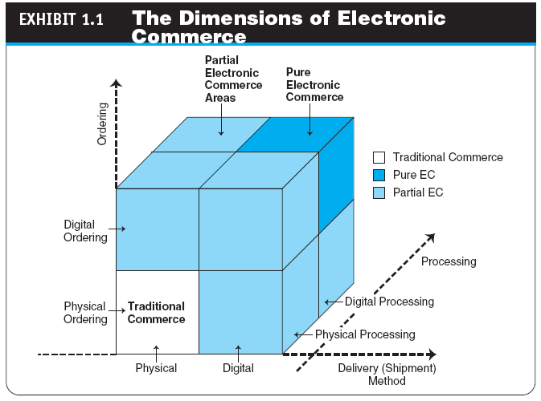
1-<number>

Slide 17
Electronic Commerce:
Definitions and Concepts
ELECTRONIC MARKETS AND NETWORKS
  electronic market (e-marketplace)
  An online marketplace where buyers and sellers meet to exchange goods, services, money, or information
  intranet
  An internal corporate or government network that uses Internet tools, such as Web browsers, and Internet protocols
  extranet
  A network that uses the Internet to link multiple intranets
1-<number>

Slide 18
The Electronic Commerce Field: Classification, Content, and a Brief History
AN EC FRAMEWORK
  EC applications are supported by infrastructure and by the following five support areas:
    People
    Public policy
    Marketing and advertising
    Support services
    Business partnerships
1-<number>

Slide 19
The Electronic Commerce Field: Classification, Content, and a Brief History
CLASSIFICATION OF EC BY THE NATURE OF THE TRANSACTIONS AND THE RELATIONSHIPS AMONG PARTICIPANTS
  business-to-business (B2B)
  E-commerce model in which all of the participants are businesses or other organizations
  business-to-consumer (B2C)
  E-commerce model in which businesses sell to individual shoppers
  e-tailing
  Online retailing, usually B2C
1-<number>

Slide 20
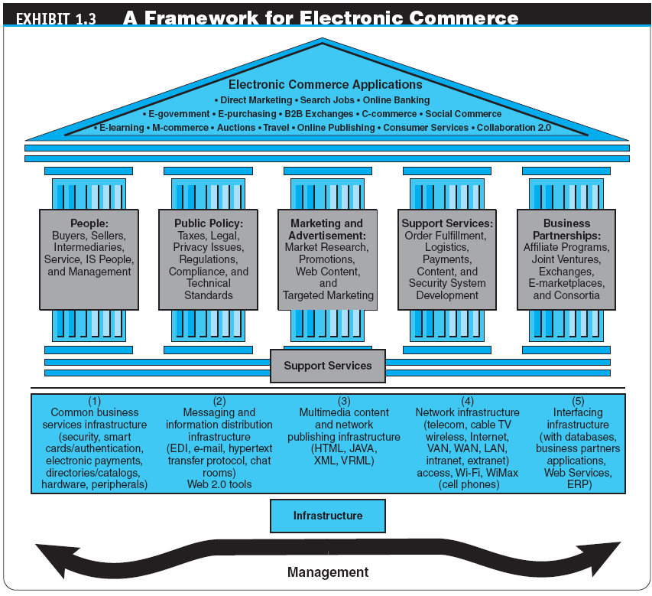
1-<number>

Slide 21
The Electronic Commerce Field: Classification, Content, and a Brief History
  business-to-business-to-consumer (B2B2C)
  E-commerce model in which a business provides some product or service to a client business that maintains its own customers
  consumer-to-business (C2B)
  E-commerce model in which individuals use the Internet to sell products or services to organizations or individuals who seek sellers to bid on products or services they need
1-<number>

Slide 22
The Electronic Commerce Field: Classification, Content, and a Brief History
  intrabusiness EC
  E-commerce category that includes all internal organizational activities that involve the exchange of goods, services, or information among various units and individuals in an organization
  business-to-employees (B2E)
  E-commerce model in which an organization delivers services, information, or products to its individual employees
1-<number>

Slide 23
The Electronic Commerce Field: Classification, Content, and a Brief History
  consumer-to-consumer (C2C)
  E-commerce model in which consumers sell directly to other consumers
  collaborative commerce (c-commerce)
  E-commerce model in which individuals or groups communicate or collaborate online
  e-government
  E-commerce model in which a government entity buys or provides goods, services, or information from or to businesses or individual citizens
1-<number>

Slide 24
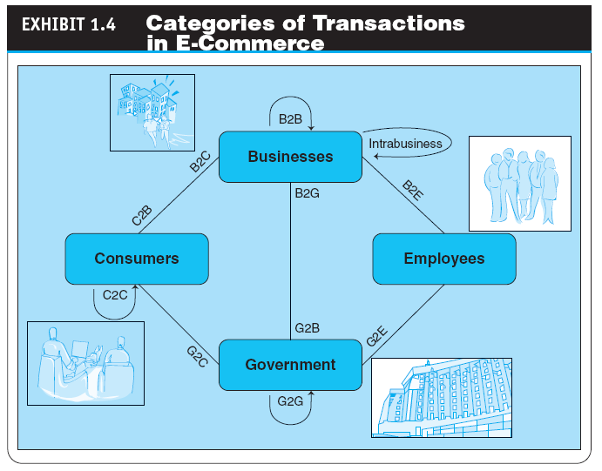
1-<number>

Slide 25
The Electronic Commerce Field: Classification, Content, and a Brief History
A BRIEF HISTORY OF EC
  The Interdisciplinary Nature of EC
  The Google Revolution
  f-commerce
  E-commerce activities conducted on Facebook or influenced by the site
  EC Failures
  EC Successes
THE FUTURE OF EC
1-<number>

Slide 26
E-Commerce 2.0:
From Social Commerce to Virtual Worlds
social computing
An approach aimed at making the human–computer interface more natural
Web 2.0
The second generation of Internet-based services that lets people collaborate and share information online in new ways, such as social networking sites, wikis, communication tools, and folksonomies
1-<number>

Slide 27
E-Commerce 2.0:
From Social Commerce to Virtual Worlds
social network
A category of Internet applications that help connect friends, business partners, or individuals with specific interests by providing free services such as photo presentation, e-mail, blogging, and so on using a variety of tools
1-<number>

Slide 28
E-Commerce 2.0:
From Social Commerce to Virtual Worlds
  social networking service (SNS)
  A service that builds online communities by providing an online space for people to build free homepages and that provides basic communication and support tools for conducting different activities in the social network
  social networking
  The creation or sponsoring of a social network service and any activity, such as blogging, done in a social network (external or internal)
1-<number>

Slide 29
E-Commerce 2.0:
From Social Commerce to Virtual Worlds
ENTERPRISE SOCIAL NETWORKS
social commerce
The e-commerce activities conducted in social networks and/or by using social software (i.e., Web 2.0 tools)
1-<number>

Slide 30
E-Commerce 2.0:
From Social Commerce to Virtual Worlds
VIRTUAL WORLDS AND SECOND LIFE
virtual world
A user-defined world in which people can interact, play, and do business; the most publicized virtual world is Second Life
  How Students Make Money in a Virtual World
THE MAJOR TOOLS OF WEB 2.0
  Wikis
  RSS feeds (Rich Site Summary)
  Blogs
  Microblogs (e.g.,Twitter)
1-<number>

Slide 31
The Digital World:
Economy, Enterprises, and Society
digital economy
An economy that is based on digital technologies, including digital communication networks, computers, software, and other related information technologies; also called the Internet economy, the new economy, or the Web economy
1-<number>

Slide 32
The Digital World:
Economy, Enterprises, and Society
digital enterprise
A new business model that uses IT in a fundamental way to accomplish one or more of three basic objectives: reach and engage customers more effectively, boost employee productivity, and improve operating efficiency; uses converged communication and computing technology in a way that improves business processes
  corporate portal
  A major gateway through which employees, business partners, and the public can enter a corporate website.
THE DIGITAL SOCIETY
1-<number>

Slide 33
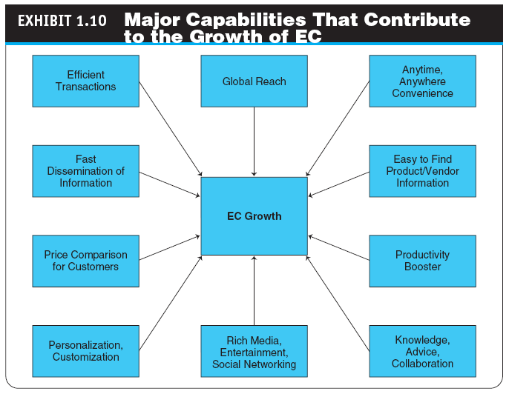
1-<number>

Slide 34
Electronic Commerce Business Models
business model
A method of doing business by which a company can generate revenue to sustain itself
1-<number>

Slide 35
Electronic Commerce Business Models
THE STRUCTURE AND PROPERTIES OF BUSINESS MODELS
  Revenue Models
  value proposition
  The benefits a company can derive from using EC
  Functions of a Business Model
1-<number>

Slide 36
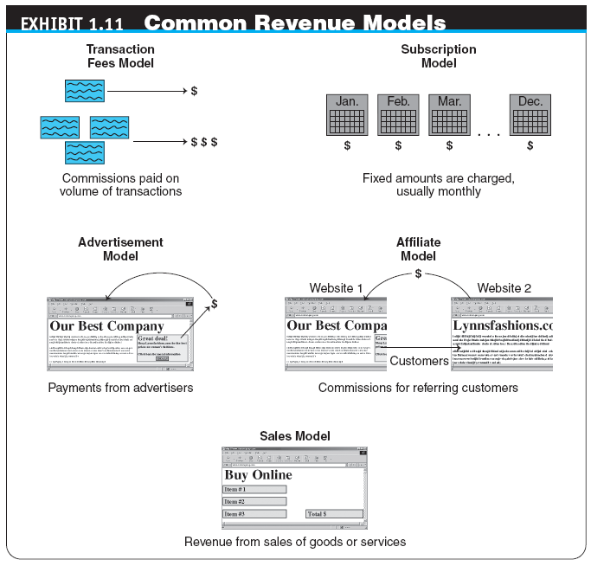
1-<number>

Slide 37
Electronic Commerce Business Models
TYPICAL EC BUSINESS MODELS
  Online direct marketing
  tendering (bidding) system
  Model in which a buyer requests would-be sellers to submit bids; the lowest bidder wins.
  Electronic marketplaces and exchanges
  Viral marketing
  Group purchasing
1-<number>

Slide 38
Managerial Issues
Is EC real?
Why is B2B e-commerce so essential and successful?
Which EC business model should I choose?
How can we exploit social commerce?
What are the top challenges of EC today?
1-<number>

Slide 39
Summary
Definition of EC and description of its various categories
The content and framework of EC
The major types of EC transactions
E-commerce 2.0
Description of social commerce and social software
1-<number>

Slide 40
Summary
The elements of the digital world
The drivers of EC
The major EC business models
Benefits of EC to organizations, consumers, and society
Limitations of e-commerce
1-<number>

